Slide 1
VERSION CONTROL

Slide 2
Introduction to Version Control
Version Control –Revision Control-Source Control
A software utility that tracks and manages changes to a filesystem
Keeps track of addition, deletion and modifications.
Repository-Database which stores all the changes.

Slide 3
Types of Version Control system
Local-No remote server in this scenario -Everything can be managed within local system
ssssss repo.hi i am shivakrishnan.edited twice.we are creating conflict
Distributed-Local copy of the repo for every developer -Can make changes without affecting remote repo

Slide 4
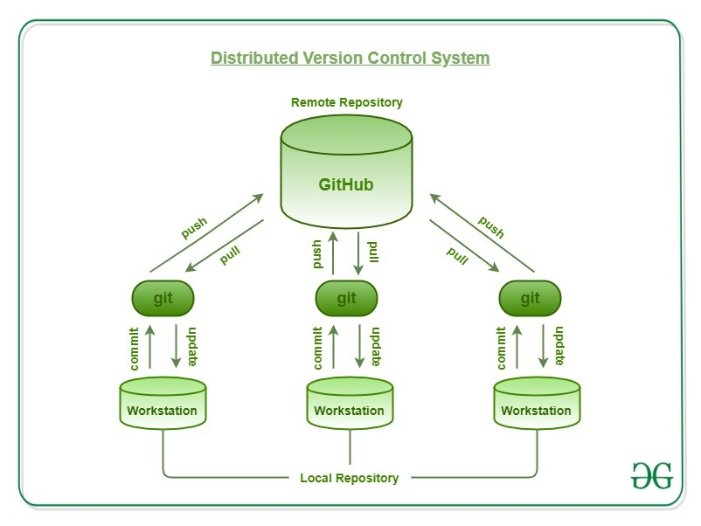
Pictorial Representation of Distributed Version Control System

Slide 5
Distributed Version Control System
GitHub (Remote Repository): GitHub acts as the shared remote repository where all developers can synchronize their work
Local Repositories (Git instances): Each developer has their own complete copy of the repository on their workstation. This includes the full history, branches, and commits.
Flow of Operation:
Commit / Update (Local): Developers make changes on their workstation and commit them to their local Git repository. This is all offline — no need to connect to GitHub yet.
Push / Pull (Remote Sync): When ready, developers push their changes to GitHub (upload) orpull changes from GitHub (download). This keeps everyone’s repositories in sync.

